Slide 1
Cookiecodec
George Tipton, Andrew Johnston, Tevin Mosley,
Liu Zhenghang, Alexander Ortegren

Slide 2
Requirements Solutions the website provides for its users
A way for artists to get their work out there
Establishes a community between artists and art buyers
Provides easily accessible and affordable art
Excellent first portfolio for inspiring art students

Slide 3
Requirements Cont. Main Features
Registration + Login/Logout
Only members should be able to access the websites functions
Image upload + edit
To enable artists to upload and change their work
Way of communications
In the form of a messaging service
Gallery
For users to find art they like or styles they want to see more of

Slide 4
Requirements Cont. Nonfunctional requirements (most important)
Data integrity
User data is stored externally in a database and only accessible to that user when logged in. Unless otherwise specified by that user.
Watermark added to pictures to prevent unauthorized copying
Usability
Users should be able to register, login and contact an artist within an hour of use
Privacy
Login information stored using encryption formula

Slide 5
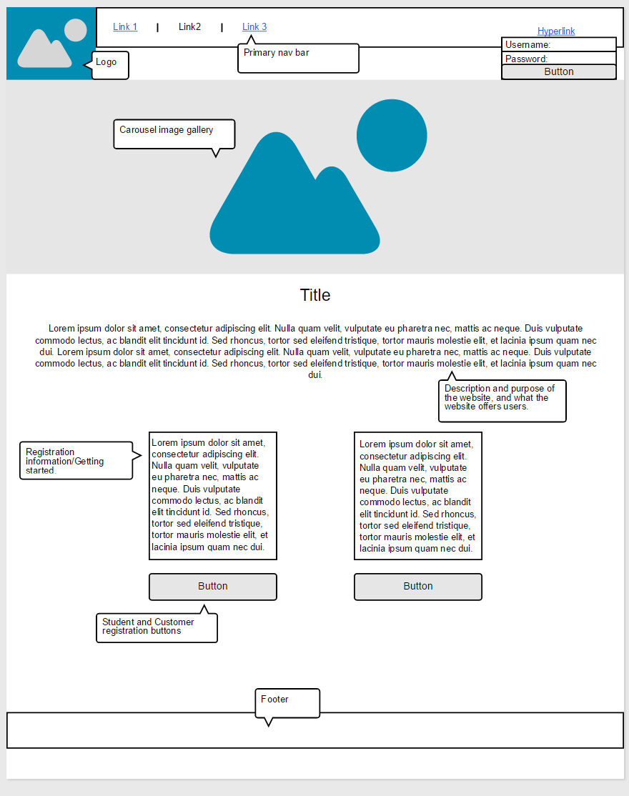
Index Wireframe

Slide 6
Design Summary
We wanted an easily accessible and navigational website
Users are greeted by a homepage and can choose to either register and login from there. It isn’t until users have registered and logged in that the website becomes fully accessible.
Gallery - again ease of use emphasized
Click on image you like – and you have the option to go to that artist
Filter to narrow the options

Slide 7
Design cont. Summary cont.
Uploading images
Only allow file formats typically associated with images
Size of image restricted
Watermark applied
Message service
Profile pages have message button which opens a message box for communication with that user
Indication of unread messages are show in the navigation dropdown bar

Slide 8
Design cont. Rationale
Registration + Login pages
Clear and concise to minimize confusion
User input acceptable – user logged in/registered, else display error message
Accessed from homepage
Homepage
Two states – logged in or not
Gallery, profile, messaging, about – all accessible from homepage

Slide 9
Design cont. Rationale cont.
Profile page
Two states – your profile page or other users
Yours:
Accessible from navigation bar
Edit profile option
Other users:
Accessible from pictures on gallery page
Message option
Displays this users uploaded art

Slide 10
Design cont. Rationale cont.
Contact user page
Ease of use again emphasized
Accessed from other user’s profile page
Write message into box – send message to user, simple as that

Slide 11
Design cont. Trade-offs
Message system – email or website message service? Settled on the latter
Easier for us to manage and users to use
Registration system – required or open for everyone? Settled on the prior
Reduces the risk, somewhat, of “bad” users (trolls)
Creates a community of sorts and users are more invested in the site
Easier to manage

Slide 12
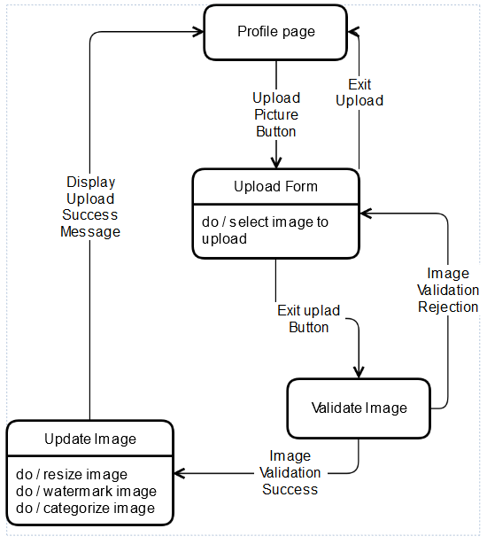
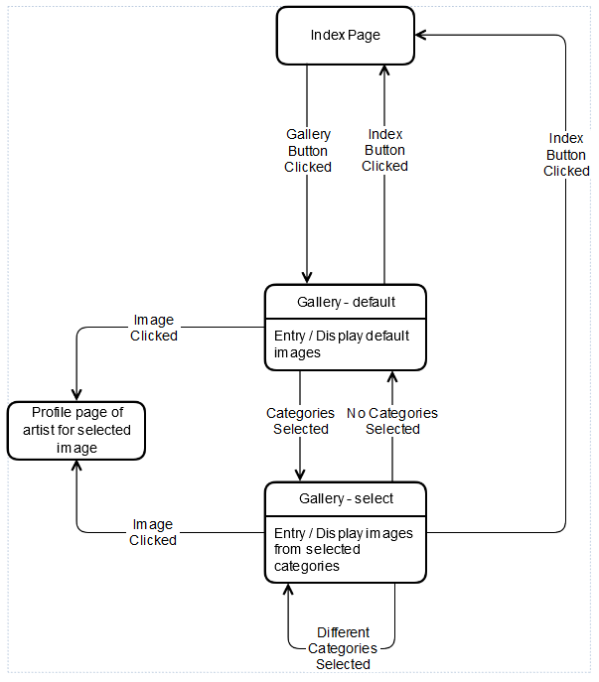
Design Diagrams
Upload
Gallery

Slide 13
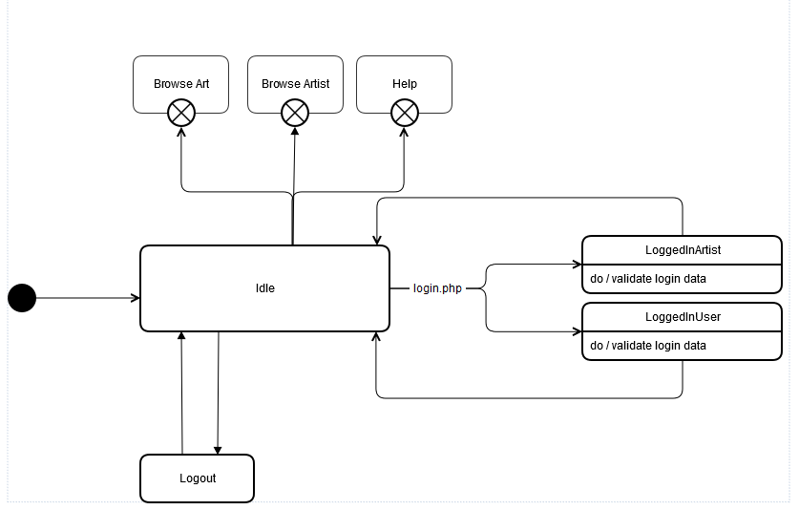
Design Diagrams Cont.
Index Page

Slide 14
Design Revisions
In the design document we wrote that after creating an account you will be taken to your profile and this has been changed to redirect to the login page.
Also, during account creation, the user will be able to write about the type of artwork they do and add a short bio of themselves.
As for the homepage, it will have different states but the page will be the same. You will be able to then access other pages if you are logged in.
The upload function has been changed to accept larger images but will still check to make sure that it in fact is an image. The image will be watermarked.

Slide 15
Design Revisions Cont.
On upload, you will be given options to categorize the type of artwork you are uploading so that this can be filtered in the gallery later on.
As for the gallery, we had an idea of 6 x 10 but we ended up creating a 4 column gallery so that users can see the images better.
The profile page will be the same for all users but users will be able to specify during setup if they are artist or just a normal user. This can also be changed when editing the profile.
The profile page, as planned, will display the artwork of that user and will give an option to message as well as an email address to contact.

Slide 16
Test Plan
Function Test Cases
Upload Image(Fully Passed)
uploaded image is displayed in artist control panel/profile page
Login(Fully Passed)
Users log in with valid E mail and password will back to main page
Contact Artist(Fully Passed)
All the users can contact artist by the "send message" link in artist user profile.
Create Account(Fully Passed)
.Account will be differed into artist and normal users in registration process.

Slide 17
Test Plan Cont.
Searching (Technically Passed has Minor Issues)
Expect outcome is listing the artwork by different searching input.
Now all the users can view the artwork in Gallary or gallary in artist user profile.
All the artwork is classified with several tags.(PHOTOGRAPHY/MODERN/OIL/DIGITAL/DRAWIN)

Slide 19
Project Status
Future Developments
Core functionality achieved
Security and privacy concerns
Passwords and vulnerabilities
Minor features
Multi-Image uploads
Sufficient Image Filtering
Improved usability / ease of use
Design and appeal
Testing, testing, testing

Slide 20
Lessons Learned
Standard issues
Group wide commitments
Matching skill sets to tasks
Patience and learning
Overall vision for the project
Communication
Organization
Don’t underestimate QA and testing
(Don’t ignore the less obvious / less appealing aspects of developments
Remaining realistic

